Slide 1
Amendment of the Constitution
Dr Swapna Manindranath Deka
Vice Principal, Dispur Law College.

Slide 2
Constituent Assembly Debates on Amendment
The Constituent Assembly Debates debated on the amendment of the constitution between 1946 and 1949 focusing on balancing flexibility with stability.
Debates centered on ensuring the Constitution was not too rigid to adapt to changing times yet not so flexible that it could be easily altered by temporary political majorities.

Slide 3
Article 368
Article 368 (1) Confers power on the Parliament for amending the Constitution.
Article 368(2) – provides the procedure as well as the types of amendment.
The two types of amendment are :
1) by a majority of the total membership of that House and by a majority of not less than 2/3 of the members of that House present and voting.
2) in case of federal principles needs to be ratified further by not less than ½ of the State Legislatures.

Slide 4
Constitution 1st Amendment Act, 1951
(by Jawaharlal Nehru Govt.)
Insertion of Article 31A, 31 B and the Ninth Schedule among others.
Article 31 A – Saves laws for acquiring of certain estates (property) from being challenged on the ground of violation of Article 14 or 19 by way of judicial review under Article 13;
Article 31B – Protects certain Acts and Regulations specified in the Ninth Schedule on the ground of violation of any provision in Part III;
Ninth Schedule – A protective covering for property laws from being challenged by judicial review.

Slide 5
Zamindari Abolition Laws
The Bihar Land Reforms Act, 1950
The Madras Estates (Abolition and Conversion into Ryotwari) Act, Amendment Act, 1950
The Uttar Pradesh Zamindari Abolition and Land Reforms Act, 1950
The Bombay Khoti Abolition Act, 1950.

Slide 6
Shankari Prasad Singh Deo v Union of India
AIR 1951 SC 458.
A five judge Constitution Bench constituted (with Chief Justice H.J. Kania and four others) to hear the matter.
Issues raised:
1) Whether the Parliament had the power to amend under Article 368 the Fundamental rights provided in Part III?
2) Whether the term “law” in Article 13(2) includes a law made by the Parliament under Article 368?

Slide 7
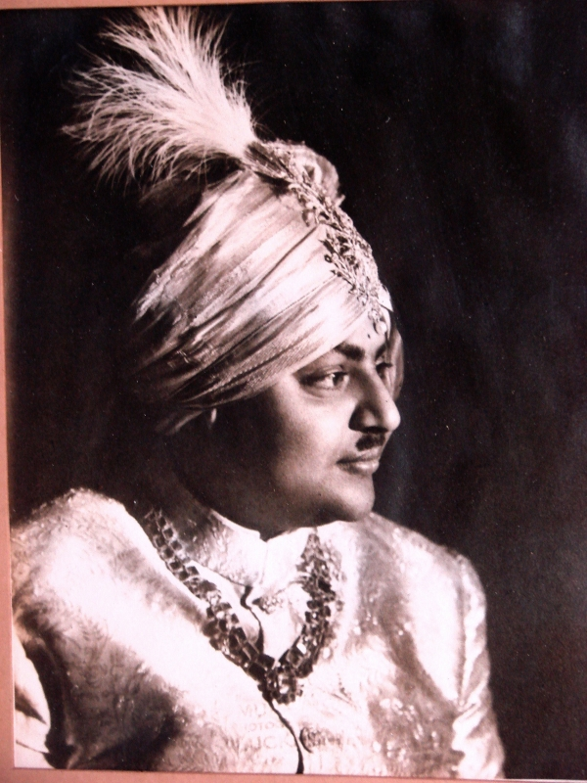
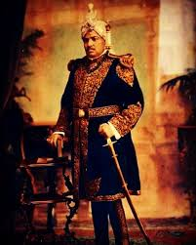
Raja Shankari Prasad Singh Deo of Panchakote, West Bengal

Slide 8
Unanimous judgment
In Shankari Prasad Singh Deo case, the unanimous five judge bench held
1) The Parliament under Article 368 has power to amend the Fundamental Rights provided in Part III.
The term “law” in Article 13 (2) does not include an amendment made by the Parliament under Article 368. The Parliament exercises constituent power to amend the Constitution under Article 368 which is distinct from the ordinary legislative power under Article 245.

Slide 9
Consequence
Thus Maharaja Shankari Prasad Singh Deo had to lose 5 bighas of land because of the Bihar Land Reforms Act, 1950, a ceiling law.

Slide 10
State of West Bengal v Bella Banerjee
AIR 1954 SC 170
Bella Banerjee challenged the West Bengal Land Development and Planning Act, 1948 that the compensation paid by the West Bengal Govt for acquisition of land for settling of migrants from Bangladesh was not adequate.
The case was heard by a four judge bench which through a unanimous judgment ruled that the compensation paid for acquisition of lands for public purposes must be just equivalent at the market rate.
Consequently the Const 4th Amnd Act, 1955 amended articles 31 and 31 A to restrict judicial review of compensation for acquired private property.

Slide 11
Sajjan Singh v State of Rajasthan
AIR 1965 SC 845
The Constitution Seventeenth Amendment, 1964 was challenged as it inserted 44 State laws in the Ninth Schedule .
The 17th Const Amnd Act 1964 modified Article 31 A to expand the definition of estate to include more ceiling laws and place them beyond judicial review.
The same issues as in Shankari Prasad were placed for arguments and the precedent set in Shankari Prasad was ruled this time but by a fractured opinion of 3:2.

Slide 12
Minority opinion of Justice Mudholkar and Justice Hidyatullah
Justice Mudholkar emphasized the importance of safeguarding the basic features of the Constitution arguing that unrestricted amendment powers under Art 368 could amend its fundamental principles.
Justice Hidyatullah asserted that fundamental rights are integral to the Constitution and should not be subjected to amendments that could compromise their sanctity.

Slide 13
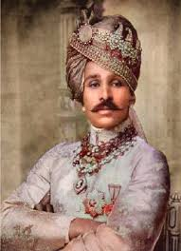
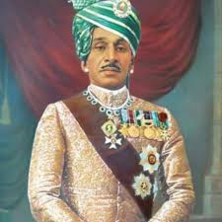
Maharaja Sajjan Singh of Ratlam in Rajasthan

Slide 14

I C Goloknath v State of Punjab,
AIR 1967 SC 1643

Slide 15
Facts of the case
The I C Golok Nath family had challenged the Punjab Land Tenures Act, 1953 on the ground that it had restricted their land ownership rights ond was a violation of their fundamental right to property under Article 19 (1) (f) and Article 31.

Slide 16
Issues raised
1) Whether the power to amend the Constitution resides in Article 368 or in the residuary power under Article 248, List I, Entry 97?
2) Whether the fundamental rights in Part III can be amended and abridged by the procedure in Article 368?
3) Whether the word ‘law’ in Article 13(2) includes “constitutional amendments”?
4) Whether the scheme of the fundamental rights enshrined in the Constitution was intended to be permanent and unamenable?
5) Whether the Const. 17th Amnd Act, 1964 violates Art. 13 of the Constitution?
6) Whether the Act of 1953 and 1962 violates fundamental rights and hence invalid?

Slide 17
Judgment (6:5)
1) Power to amend the Constitution is derived from Articles 245, 246 and 248 and not from 368 which deals with only procedure of amendment.
2) Amendment is law within the meaning of Article 13 and hence if it violates the fundamental rights in Part III they are void.
3) The word “law” in Article 13 includes “constitutional amendments” and hence they can be challenged on the ground of violation of Part III.
4) The scheme of fundamental rights are amenable. Parliament shall have no power from the date of the decision to amend Part III.
5) By applying the doctrine of “Prospective Overruling”, the Const. 17th Amnd Act cannot be challenged.
6) The Punjab Security of Land Tenures Act, 1953 and the Mysore Land Reforms Act, 1962 are valid.

Slide 18
Constitution 24th Amendment Act, 1971
It changed the title of Art.368 – “Power of Parliament to amend the Constitution and procedure therefor” (Art.368)
It gave a constituent power to the Parliament to amend by way of addition, variation repeal; (Art. 368 (1))
It made obligatory for the President to give his assent to the amended bill. (Art. 368 (2))
It provide judicial review shall not apply to constitutional amendments. (Art. 368 (3))

Slide 19
Did Golok Nath and his family win the case?
Legally Yes.
But because of the application of the Doctrine of Prospective Overruling they could not get back the property acquired by the Punjab Govt.

Slide 20
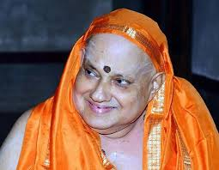
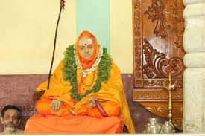
Swami Kesavananda Bharati ; Head of Edaneer Math in kasaragod district, Kerala.

Slide 21
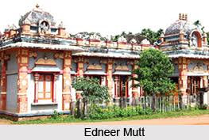
Edneer Mutt
The Edneer Mutt is a 400 year old Hindu monastic institution in Kasaragod Kerala dedicated to the Advaita philosophy od Adi Sankaracharya.
Renowned seat of spirituality , Sanskrit learning and arts like Yakshaganga famously headed by late Kesavananda Bharati who died on 6 sept 2020 at 79.

Slide 22
Swami Sripadgalvaru Kesavananda Bharati v State of Kerala AIR 1973 SC 1641
Keasavananda Bharati challenged the constitutional validity of the 24th, 25th and 29th Amendment and the Kerala Land Reforms Act, 1963 and the Kerala Land Reforms (Amendment) Act, 1969 on the ground the it intended to take away the ownership rights of the Edneer Muth whose head was the petitioner..
Through the amendments to the Kerala Land Reforms Act, the Kerala govt intended to take away a large portion of land owned by the Edneer Mutt and limit the mutt’s ability to manage its own property.

Slide 23
Controversial
24th, 25th and 29th Amendments
The 25th Amnd Act 1971 modifies Art. 31(2) replacing the term compensation’ with “amount” for state acquisition of private property and keeping with beyond judicial review. It also inserts Art. 31(C) making DPSP under Art. 39 (b) and (c) beyond judicial review on the ground of violation of fundamental rights under 14, 19 and 31.
The 29th Amnd Act, 1972 added two Kerala Land Reforms Act, 1963 and Kerala Land Reforms (Amendment) Act, 1969 to the Ninth Schedule to protect them from judicial review under Art. 31 B.

Slide 24
Issues
Two major issues emerged which was heard by a thirteen judge bench (7:6):
1) Whether Parliament can amend the fundamental Rights?
2) Whether there is any limit on the Parliament’s amending power on Article 368?

Slide 25
Judgment (7:6)
Parliament can amend the fundamental rights provided in Part III
2) But the amending power of the Parliament under Art.368 is unlimited. In fact it is limited by the doctrine of Basic Structure. Certain core values in the constitution must always remain intact.

Slide 26
Did Kesavananda Bharati win the Case?
Legally No.
The Kerala Land Reforms Act were upheld.
The land taken from the Edneer Mutt was not returned.
The constitutional amendments protecting the ceiling laws were mostly upheld.
So Kesavanada Bharati lost his property.

Slide 27
Constitution 42nd Amnd Act, 1976
Two new clauses inserted in Art. 368- Clause (4) and (5)
Clause 368(4) – No amendment made in the Constitution including Part III whether before or after the 42nd Amnd Act 1976 shall be called in question in any court.
Clause 368(5) For removal of doubts there shall be no limitation on the amending power of the Parliament whether by way of addition, variation or repeal.

Slide 28
Minerva Mills v Union of India
AIR 1980 SC 1789 (4:1 judges)
In 1971, Minerva Mills v Union of India, a textile undertaking in Karnataka was taken over by the Central Govt.
Nationalisation occurred under laws addressing sick textile undertakings .
The Company and its shareholders filed a writ petition challenging the takeover.
Sec 4 and 55 of the Const. (42nd Amnd Act, 1976) were specifically challenged.

Slide 29
Issues raised
1) Whether Parliament has unlimited power to amend the Constitution under Art. 368
2) Whether the 42nd Amnd violated the basic structure doctrine?
3) Whether judicial review of constitutional amendments could be excluded?
40 Whether amended Article 31 C disturbed the balance between Fundamental Rights and Directive Principles?
4) Whether nationalization laws were protected from challenge under Article 31B?

Slide 30
Judgment
1) Limited Amending Power
2) Invalidation of Article 368(4) and 368(5);
3)Judicial Review as Basic Feature affiremed.
4) Basic Structure Reaffirmed;
5) Balance between Parts II and IV
6) Section 4 of 42nd Amnd struck down;
7) Original Article 31 C upheld in its original form.

Slide 31
Litigation continues
There is a plethora of cases even after Minerva Mills Case.
The debate is Parliamentary Supremacy under Article 368 v Judicial Supremacy under Article 13.
The doctrine of Basic Structure continues to restrict Parliamentary Supremacy under Article 368.
It in fact reiterates Judicial Review over Article 368.

Slide 32
The End
Thanks for a patient hearing.

